Slide 1
DATA LINK LAYER

Slide 2
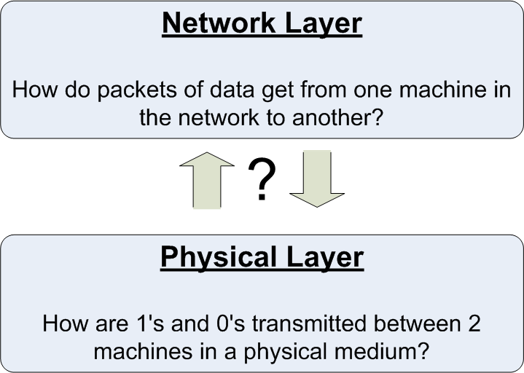
Data Link Layer Overview

Slide 3
Data Link Layer Design Issues
Error Control
Correction and Detection Schemes
Framing
DLL translates the physical layer's raw bit stream into discrete units (messages) called frames.
Flow Control
Medium Access

Slide 4
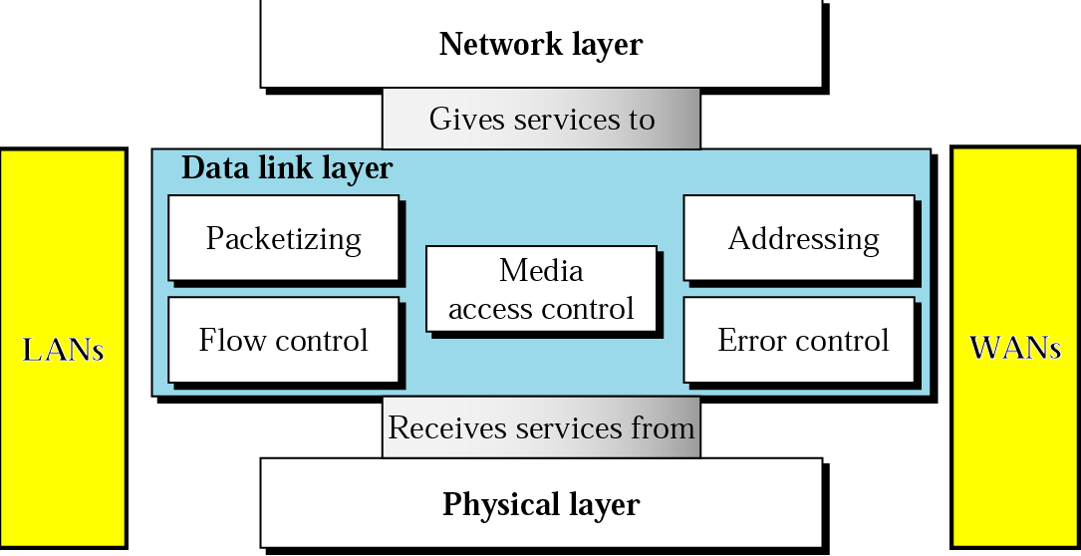
Overview of DLL

Slide 5
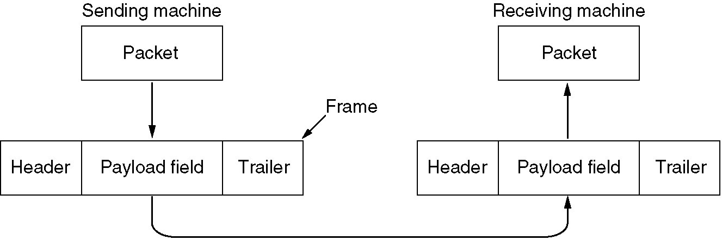
Functions of the Data Link Layer
Dealing with transmission errors.
Regulating the flow of data so that slow receivers are not swamped by fast senders
Providing a well-defined service interface to the network layer.
For this, the data link layer takes the packets it gets from the network layer and encapsulates them into frames for transmission. Each frame contains a frame header, a payload field for holding the packet, and a frame trailer

Slide 6
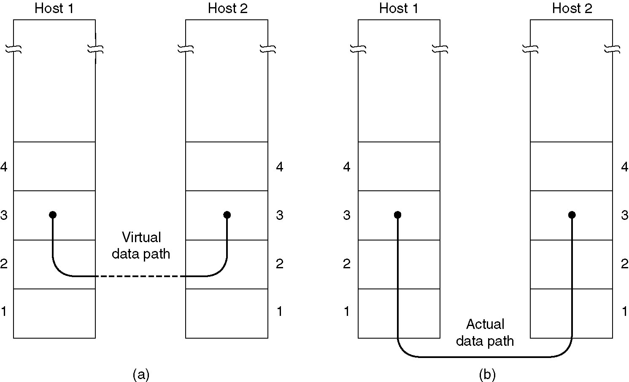
Services Provided to Network Layer
(a) Virtual communication.
(b) Actual communication.
The principal service is transferring data from the network layer on the source machine to the network layer on the destination machine.

Slide 7
Types of Services Provided To The Network Layer
Unacknowledged Connectionless service
Acknowledged Connectionless service
Acknowledged Connection-Oriented service

Slide 8
Unacknowledged Connectionless service
Losses are taken care of at higher layers
Used on reliable medium like coax cables or optical fiber, where the error rate is low.
Appropriate for voice, where delay is worse than bad data.

Slide 9
Acknowledged Connectionless service
Useful on unreliable medium like wireless.
Acknowledgements add delays.
Adding ack in the DLL rather than in the N/w Layer is just an optimization and not a requirement. Leaving it for the NL is inefficient as a large message (packet) has to be resent in that case in contrast to small frames here.
On reliable channels, like fiber, the overhead associated with the ack is not justified.

Slide 10
Acknowledged Connection-oriented Service
Most reliable
Guaranteed service –
Each frame sent is indeed received
Each frame is received exactly once
Frames are received in order
Special care has to be taken to ensure this in connectionless services

Slide 11
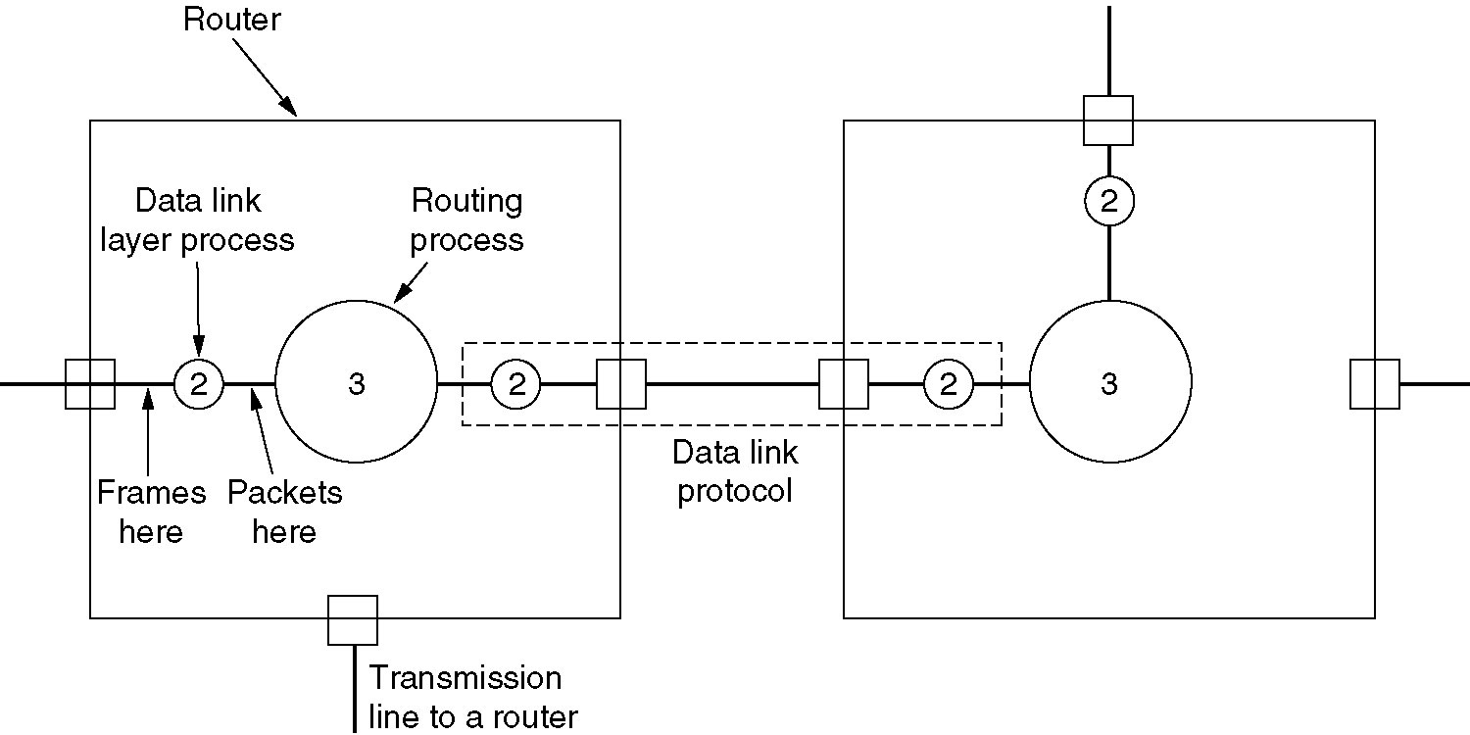
Placement of Data Link Protocol

Slide 12
Multiple Access
Problem: When two or more nodes transmit at the same time, their frames will collide and the link bandwidth is wasted during collision
How to coordinate the access of multiple sending/receiving nodes to the shared link???
Solution: We need a protocol to coordinate the transmission of the active nodes
These protocols are called Medium or Multiple Access Control (MAC) Protocols belong to a sublayer of the data link layer called MAC (Medium Access Control)
What is expected from Multiple Access Protocols:
Main task is to minimize collisions in order to utilize the bandwidth by:
Determining when a station can use the link (medium)
what a station should do when the link is busy
what the station should do when it is involved in collision

Slide 13
Medium Access Control

Slide 14
MAC Overview
The MAC (sub-)layer
ALOHA Protocols
Carrier-Sense Protocols
Wireless protocols

Slide 15
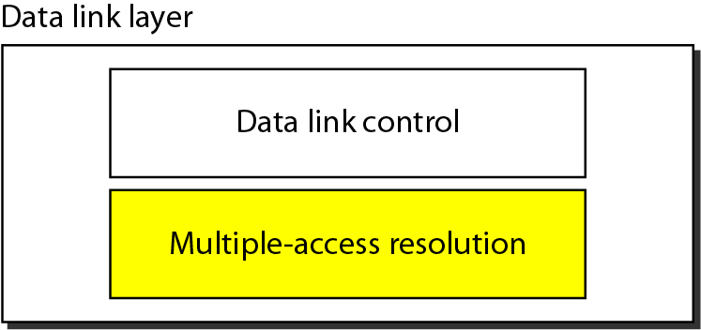
MAC
Responsible for error and flow control
Link Layer Control (LLC)
Control
MAC
Responsible for framing and MAC address and Multiple Access Control
Data link layer divided into two functionality-oriented sub-layers

Slide 16
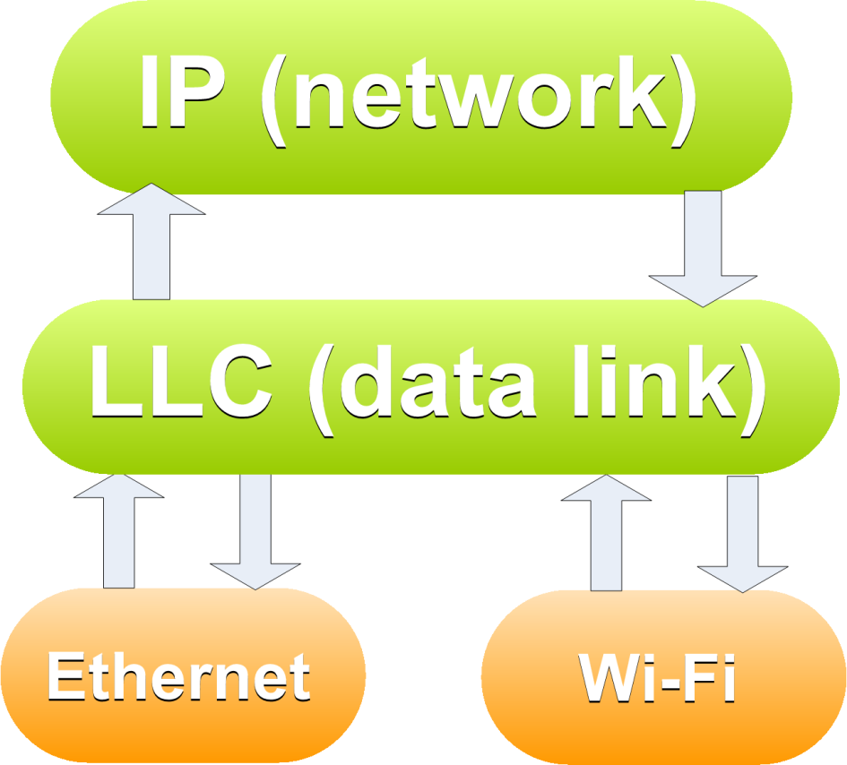
The MAC sub-layer
Data-Link Layer provides packet send/receive service to Network Layer

Slide 17
The MAC sub-layer
Physical Layer provides bits streams send/receive service to Data-Link Layer

Slide 18
The MAC sub-layer
But, different media have different constraints about multiple nodes accessing the medium

Slide 19
The MAC sub-layer
We could hide this all in the physical layer:
send(bit b); returns once the medium is reserved and the bit has been sent
Very inefficient
We want to reserve the medium for a longer space of time (i.e. at least the length of a single frame)

Slide 20
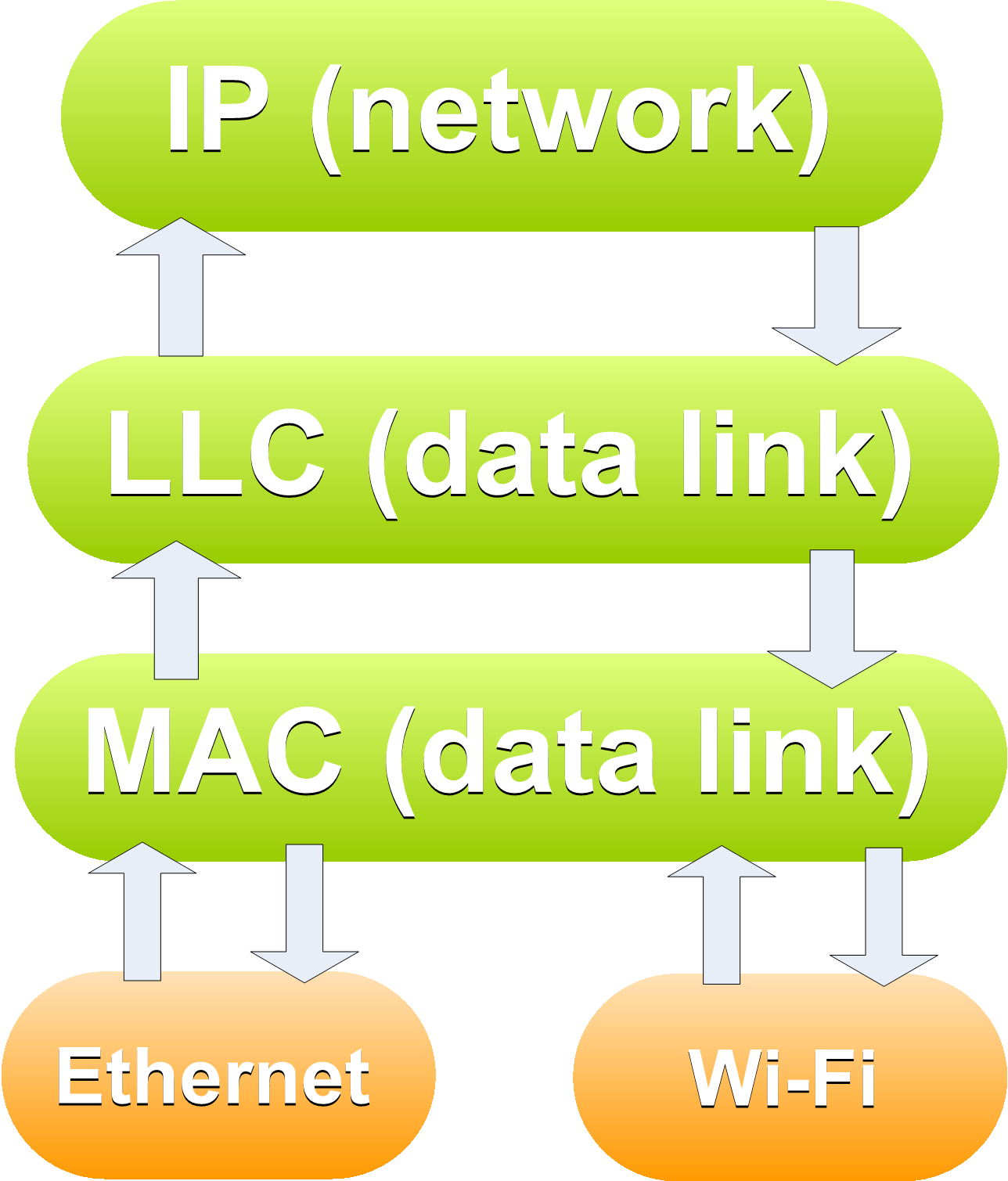
The MAC sub-layer
MAC layer provides medium-access service to the Data-Link layer
A separate protocol is needed to implement the service for each different transmission medium

Slide 21
Channel Allocation Problem
How to allocate a multi-access channel among competing users?
We need a set of rules (i.e. a protocol) to allow each user to communicate and avoid interference.
A variety of solutions to this problem that are used in practice. These solutions can be classified as either static or dynamic.

Slide 22
Static Channel Allocation
With a static approach, the channel's capacity is essentially divided into fixed portions; each user is then allocated a portion for all time.
If the user has no traffic to use in its portion, then it goes unused.
Generally, a static allocation performs better when the traffic is predictable

Slide 23
Static Channel Allocation Techniques
Time Division Multiple Access (TDMA)
The time axis is divided into time slots of a fixed length.
Each user is allocated a fixed set of time slots at which it can transmit
TDMA requires that users be synchronized to a common clock
Typically extra overhead bits are required for synchronization.
Frequency Division Multiple Access (FDMA)
The available frequency bandwidth is divided into disjoint frequency bands. A fixed band is allocated to each user.
FDMA requires a guard band between user frequency bands to avoid cross-talk.
Code Division Multiple Access (CDMA)
This technique is used in many wireless networks

Slide 24
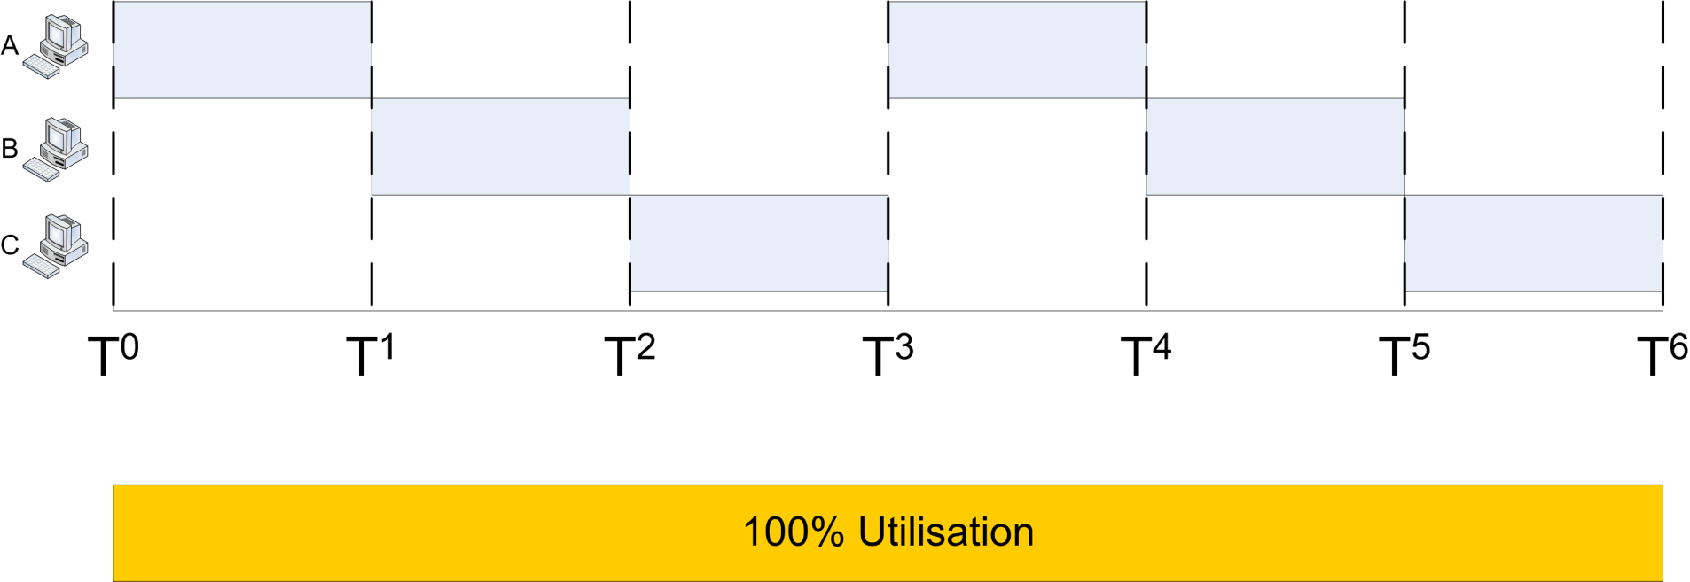
Static Channel Allocation: TDMA
Multiplexing works with constant traffic
Time-Division fails with heterogeneous traffic

Slide 25
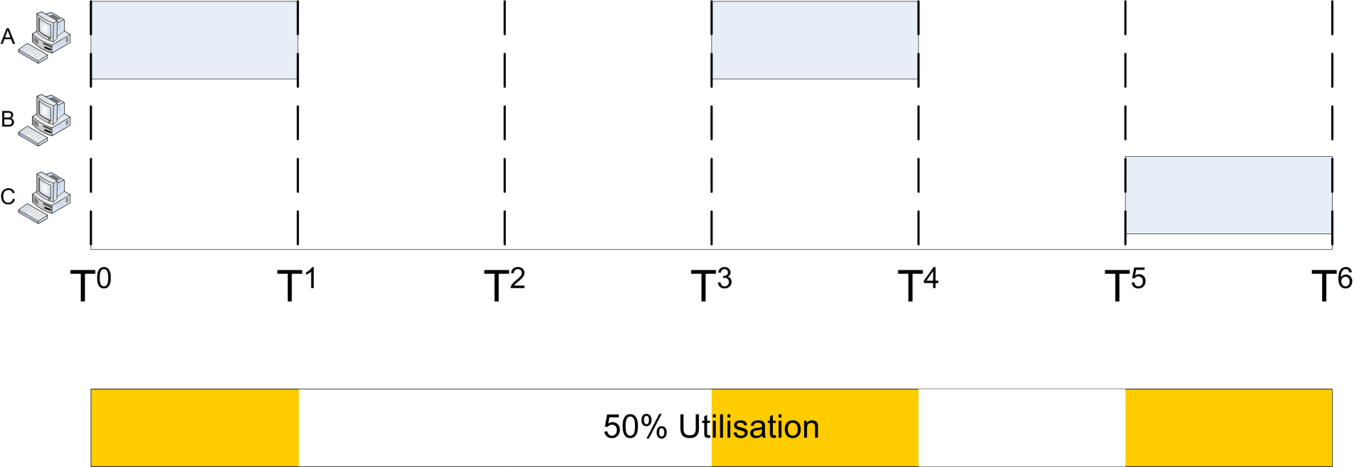
Channel Allocation Problem
Multiplexing works with constant traffic
Time-Division fails with heterogeneous traffic

Slide 26
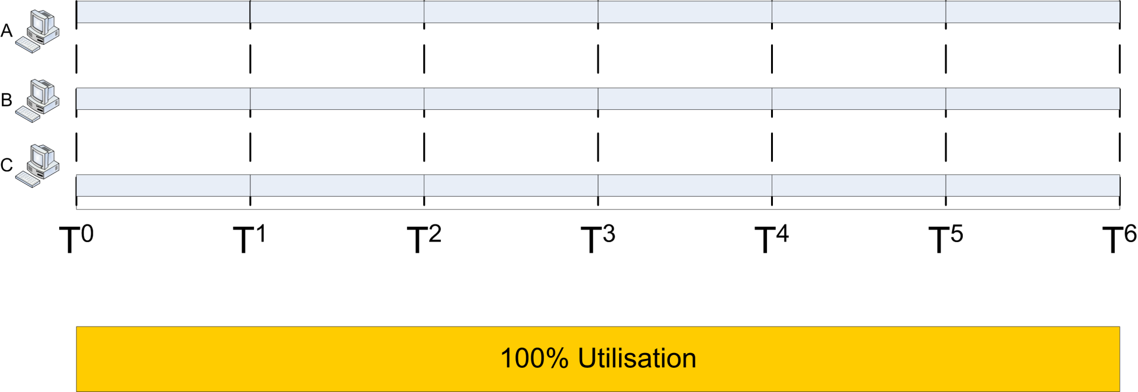
Static Channel Allocation: FDMA
Multiplexing works with constant traffic
Frequency-Division fails with bursty traffic

Slide 27
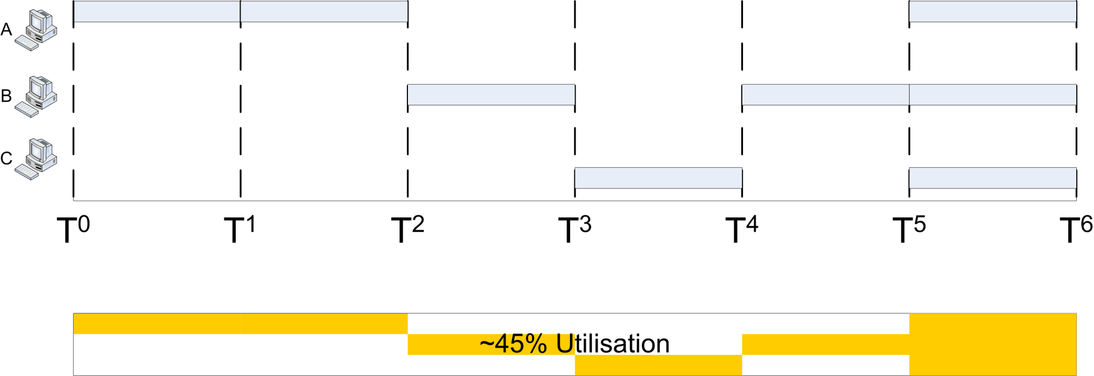
Channel Allocation Problem
Multiplexing works with constant traffic
Frequency-Division fails with bursty traffic

Slide 28
Channel Allocation Problem
With bursty, heterogeneous traffic we must find a dynamic way to allocate a node access to the channel
When a node has no traffic to send it does not waste bandwidth
When a node has traffic to send it can obtain all capacity of the channel, not just a slice

Slide 29
Dynamic Channel Allocation
With a dynamic approach the allocation of the channel changes based on the traffic generated by the users.
A dynamic channel allocation tries to get better utilization and lower delay on a channel when the traffic is unpredictable.

Slide 30
Dynamic Channel Allocation
Station Model.
Single Channel Assumption.
Collision Assumption.
(a) Continuous Time. (b) Slotted Time.
(a) Carrier Sense. (b) No Carrier Sense.

Slide 31
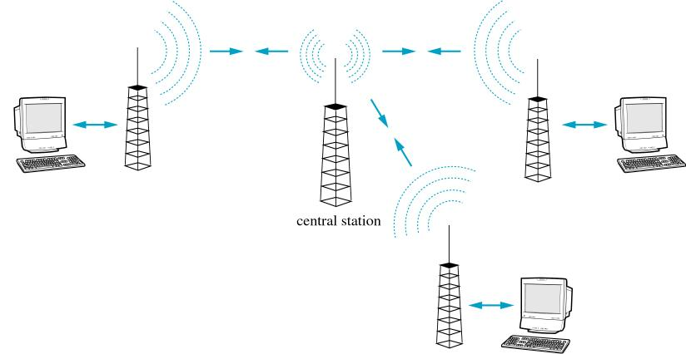
ALOHA Protocols
Classical shared-medium problem
Radio towers all in range of central antenna
Two concurrent senders = collision (both frames are lost entirely)

Slide 32
ALOHA Protocols
Two General Problems:
How to know when a collision has happened?
How to share the medium in general when collisions cannot be predicted?
Two General Solutions:
Resend when a collision happens and hope for the best (Pure ALOHA)
Synchronise sending to a timer to reduce – but not eradicate - collisions (Slotted ALOHA)

Slide 33
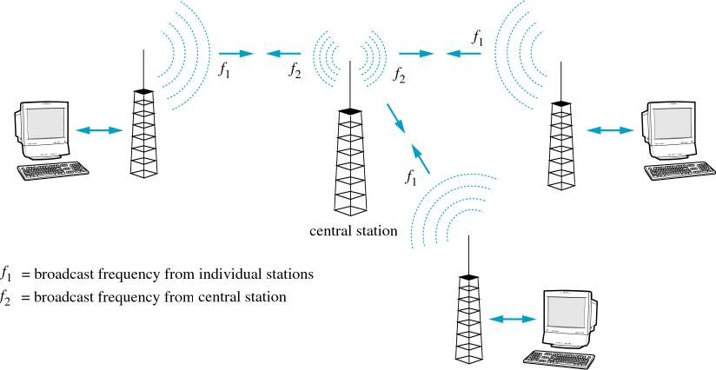
ALOHA – Collision Detection
Central station bounces ACK back to sender
ACKs sent on separate frequency so never collide
If ACK not received then sender assumes collision

Slide 34
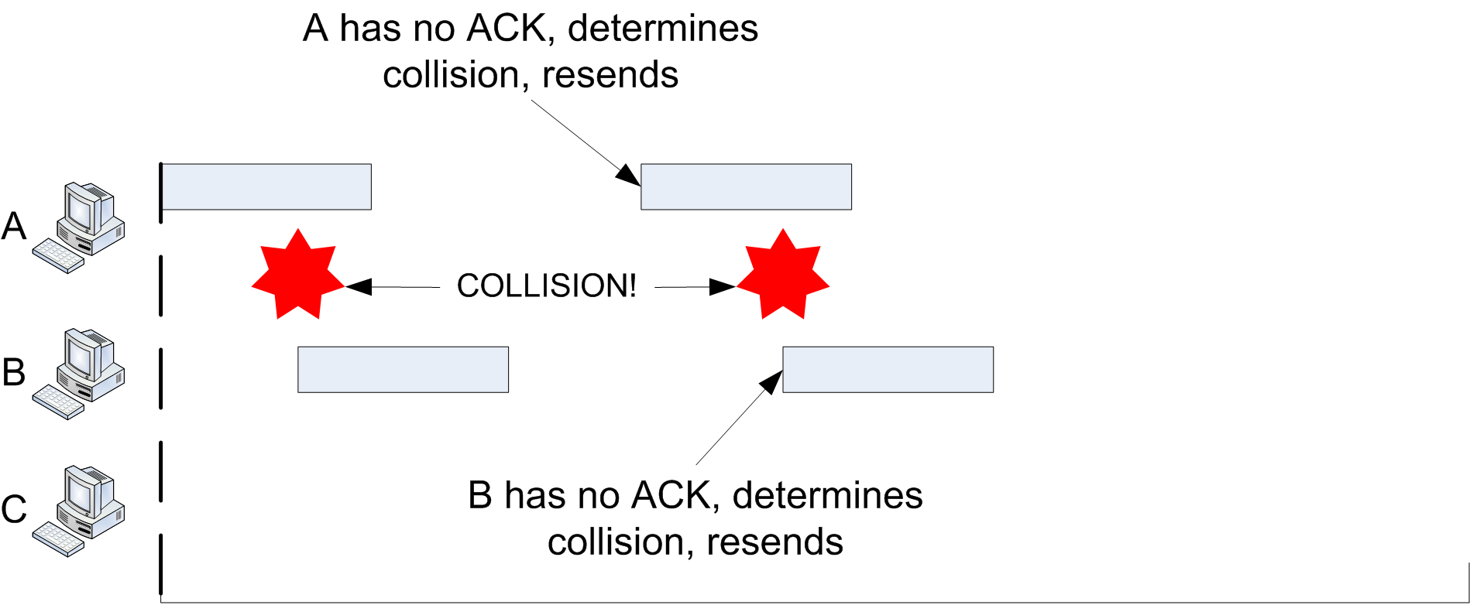
Pure ALOHA
On Collision…
Wait random amount of time and resend
Randomisation is vital

Slide 35
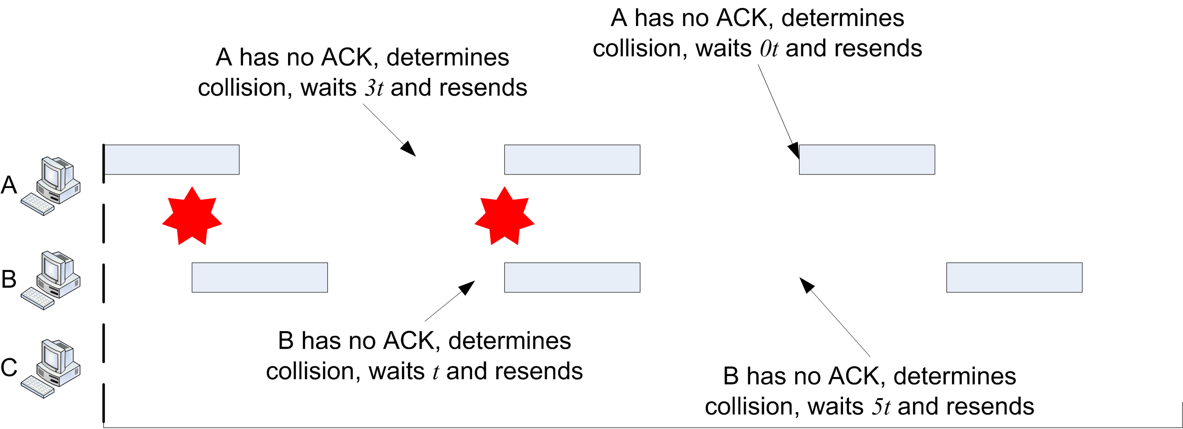
Pure ALOHA
On Collision…
Wait random amount of time and resend
Randomisation is vital

Slide 36
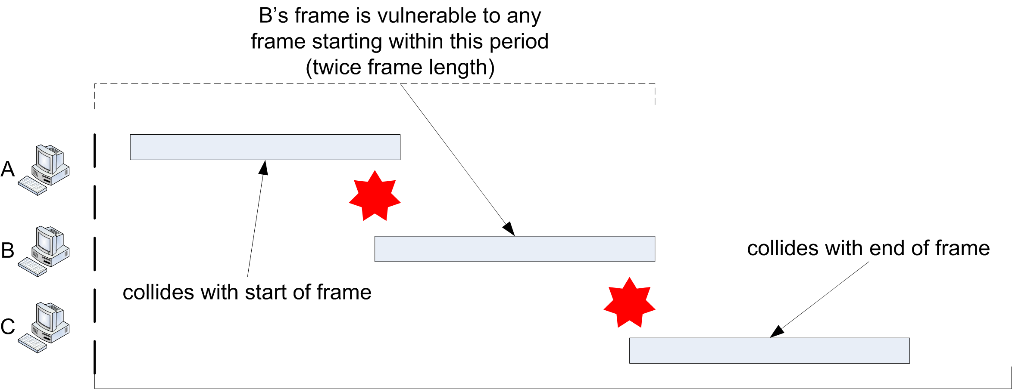
Pure ALOHA
Weakness: potential for collision is large
For a frame-period of length F, the frame is vulnerable for a period of 2F

Slide 37
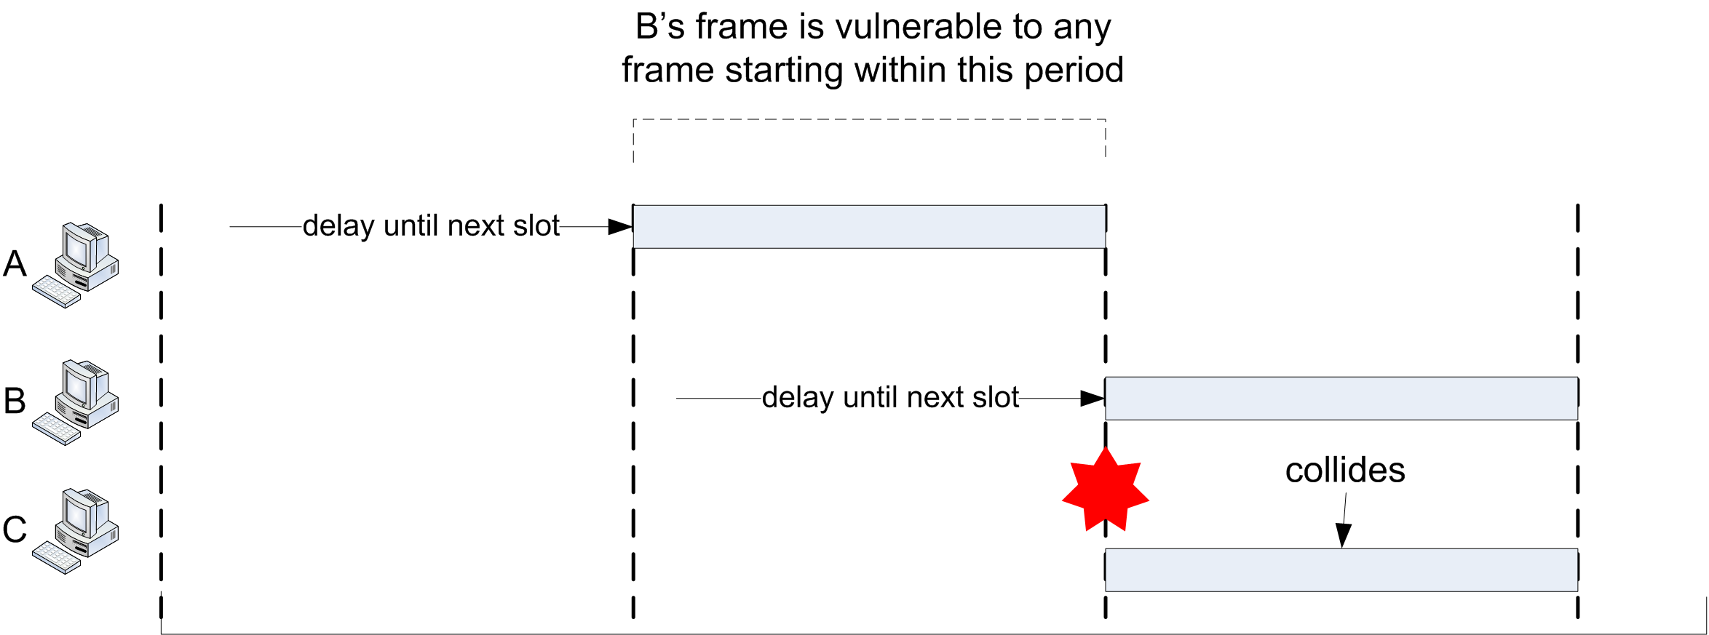
Slotted ALOHA
Time divided in to slots of size F
Frames delayed until beginning of the next slot

Slide 38
Slotted vs. Pure ALOHA
Both use randomisation after collision
Slotted reduces probability of collision
If frame is ready in middle of period:
In Pure ALOHA: I will begin sending and destroy any currently sending frames
In Slotted ALOHA: I will wait and only destroy other waiting frames

Slide 39
ALOHA: Throughput/Performance
Reducing collisions increases throughput
Throughput S = Number of frames successfully received for a given unit time
Generally:
G = offered load (Average number of frames generated by the all stations during one frame transmission time)
P(s) = probability of success for a single frame
S = G × P(s)

Slide 40
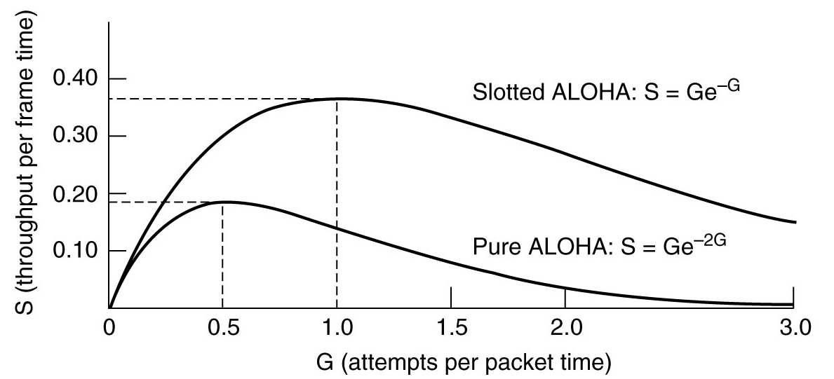
ALOHA: Throughput/Performance
We can also increase S by increasing G
But P(s) is a function of G
For Pure ALOHA: P(s) = e^{-2G}, S = Ge^{-2G}
For Slotted ALOHA: P(s) = e^{-G}, S = Ge^{-G}

Slide 41
Slotted ALOHA – Efficiency
Suppose N nodes with many frames to send, each transmits a frame in any slot with probability p.
(For simplicity, we consider the probability, p, as same as for all nodes.)
Probability that any given node has success transmitted in a slot = 1 node transmits and N-1 nodes do not transmit
= p(1-p)^{N-1}
Probability that any node has a success = Np(1-p)^{N-1}
(This is the efficiency, when there are N active nodes.)

Slide 42
Slotted ALOHA – Efficiency
For max efficiency with N nodes, find p* that maximizes Np(1-p)^{N-1}
For a higher number of nodes:
“take the limit of Np*(1-p*)^{N-1} as N goes to infinity”,
gives 1/e = 0.37

Slide 43
PURE ALOHA – Efficiency
P(successful transmission by given node)
=
P(node transmits) ^{x} P(no other node transmits in [t₀-1,t₀] ^{x} P(no other node transmits in [t₀, t₀+1]
= p . (1-p)^{N-1 .} (1-p)^{N-1}
= p . (1-p)^{2(N-1)}
… choosing optimum p and then letting n -> infinity ...
^{= 1/(2e) = 0.18}
Even worse !

Slide 44
Advantage of ALOHA protocols
A node that has frames to be transmitted can transmit continuously at the full rate of channel (R bps) if it is the only node with frames
Simple to be implemented
No master station is needed to control the medium
Disadvantage
If (M) nodes want to transmit, many collisions can occur and the rate allocated for each node will not be on average R/M bps
This causes low channel utilization

Slide 45
Example – ALOHA and Slotted ALOHA
Suppose that a radio system uses a 9600 bps channels for sending call setup request messages to a base station. Suppose that packets are 120 bits long, that the timeout is 20ms, and that the backoff is uniformly distributed between 1 and 7. What is the maximum throughput possible with ALOHA and slotted ALOHA?

Slide 46
Example – ALOHA and Slotted ALOHA
The system transmits packets at a rate of 9600 bits/second
For1 packet/120bits = 80 packets/second.

Slide 47
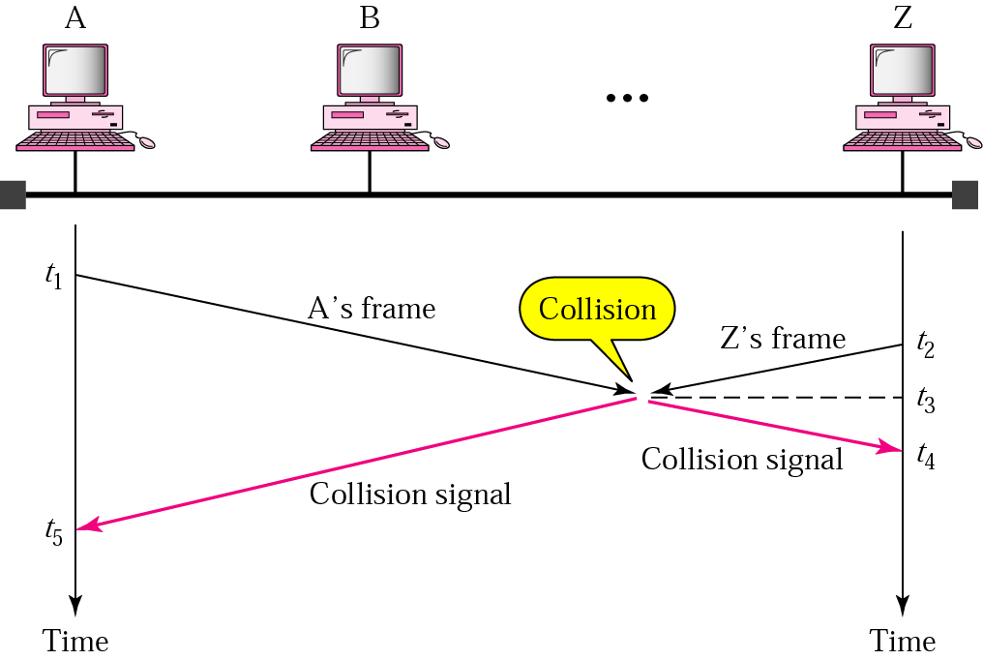
Random Access – Carrier Sense Multiple Access (CSMA)
To improve performance, avoid transmissions that are certain to cause collisions
Based on the fact that in LAN, propagation time is very small
➔ If a frame was sent by a station, All stations knows immediately so they can wait before start sending
➔ A station with frames to be sent, should sense the medium for the presence of another transmission (carrier) before it starts its own transmission
This can reduce the possibility of collision but it cannot eliminate it.
Collision can only happen when more than one station begin transmitting within a short time (the propagation time period)

Slide 48
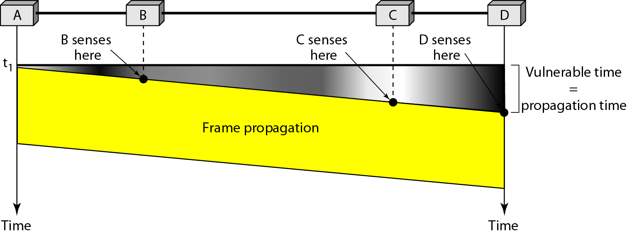
Random Access – Carrier Sense Multiple Access (CSMA)
Vulnerable time for CSMA is the maximum propagation time
The longer the propagation delay, the worse the performance of the protocol

Slide 49
Types of CSMA Protocols
Different CSMA protocols that determine:
What a station should do when the medium is idle?
What a station should do when the medium is busy?
Non-Persistent CSMA
1-Persistent CSMA
p-Persistent CSMA

Slide 50
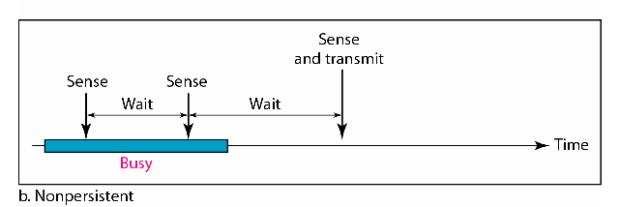
Nonpersistent CSMA
A station with frames to be sent, should sense the medium
If medium is idle, transmit; otherwise, go to 2
If medium is busy, (backoff) wait a random amount of time and repeat 1
Non-persistent Stations are deferential (respect others)
Performance:
Random delays reduces probability of collisions because two stations with data to be transmitted will wait for different amount of times.
Bandwidth is wasted if waiting time (backoff) is large because medium will remain idle following end of transmission even if one or more stations have frames to send
Random Waiting times
Wasted time

Slide 51
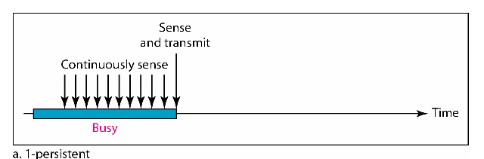
1-persistent CSMA
To avoid idle channel time, 1-persistent protocol used
Station wishing to transmit, listens to the medium:
If medium idle, transmit immediately;
If medium busy, continuously listen until medium becomes idle; then transmit immediately with probability 1
Performance
1-persistent stations are selfish
If two or more stations becomes ready at the same time, collision guaranteed

Slide 52
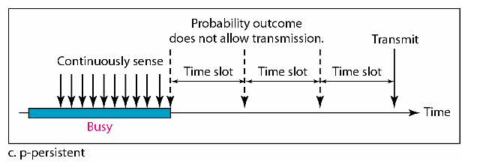
P-persistent CSMA
Time is divided to slots where each Time unit (slot) typically equals maximum propagation delay
Station wishing to transmit listens to the medium:
If medium idle,
transmit with probability (p), OR
wait one time unit (slot) with probability (1 – p), then repeat 1.
If medium busy, continuously listen until idle and repeat step 1
Performance
Reduces the possibility of collisions like nonpersistent
Reduces channel idle time like 1-persistent

Slide 53
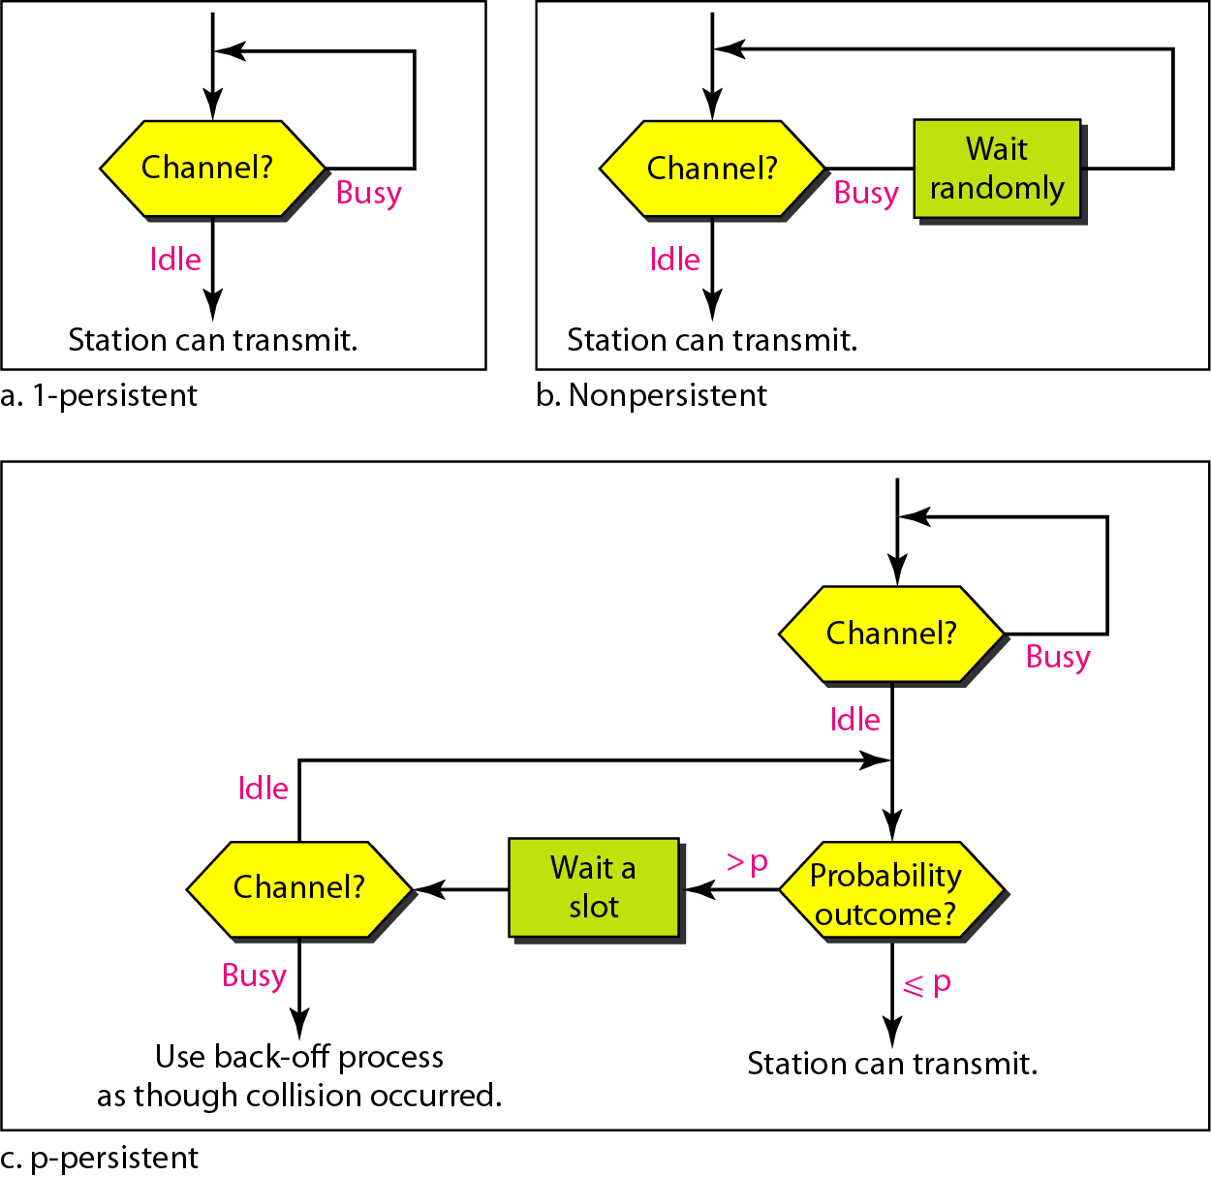
Flow diagram for three persistence methods

Slide 54
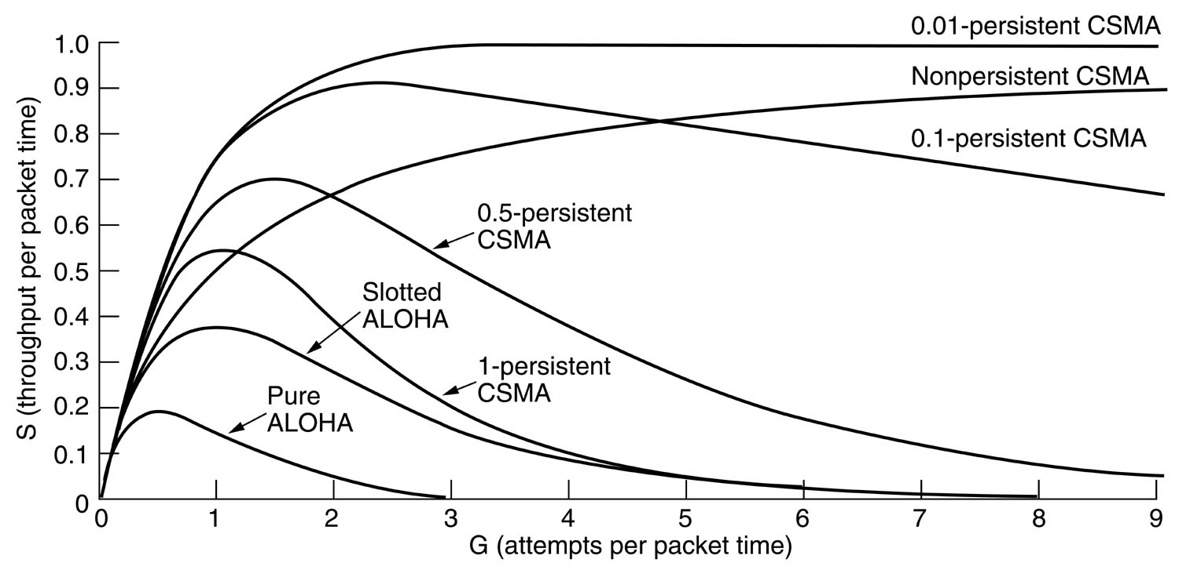
CSMA Performance

Slide 55
CSMA/CD (Collision Detection)
CSMA (all previous methods) has an inefficiency:
If a collision has occurred, the channel is unstable until colliding packets have been fully transmitted
CSMA/CD (Carrier Sense Multiple Access with Collision
Detection) overcomes this as follows:
While transmitting, the sender is listening to medium for collisions.
Sender stops transmission if collision has occurred reducing channel wastage .
CSMA/CD is Widely used for bus topology LANs (IEEE 802.3, Ethernet).

Slide 56
CSMA/CD Protocol
Use one of the CSMA persistence algorithm for transmission
(non-persistent, 1-persistent, p-persistent)
If a collision is detected by a station during its transmission then it should do the following:
Abort transmission and
Transmit a jam signal (48 bit) to notify other stations of collision so that they will discard the transmitted frame also to make sure that the collision signal will stay until detected by the furthest station
After sending the jam signal, backoff (wait) for a random amount of time, then
Transmit the frame again

Slide 57
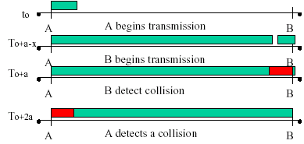
CSMA/CD
Question: How long does it take to detect a collision?
Answer: In the worst case, twice the maximum propagation delay of the medium
Note: a = maximum propagation delay

Slide 58
CSMA/CD
Restrictions of CSMA / CD:
Packet transmission time should be at least as long as the time needed to detect a collision (2 * maximum propagation delay + jam sequence transmission time)
Otherwise, CSMA/CD does not have an advantage over CSMA

Slide 59
Exponential Backoff Algorithm
Ethernet uses the exponential backoff algorithms to determine the best duration of the random waiting period after the collision happens
Algorithm:
Set “slot time” equal to 2*maximum propagation delay + Jam sequence transmission time (= 51.2 usec for Ethernet 10-Mbps LAN)
After K^{th} collision, select a random number (R) between 0 and
2^{k} –1 and wait for a period equal to (R*slot time) then retransmit when the medium is idle, for example:
After first collision (K=1), select a number (R) between 0 and 2¹ –1 {0 ,1} and wait for a period equal to R*slot times (Wait for a period 0 usec or 1x51.2 usec) then retransmit when the medium is idle
Do not increase random number range, if K=10
➔ Maximum interval {0 – 1023}
Give up after 16 unsuccessful attempts and report failure to higher layers

Slide 60
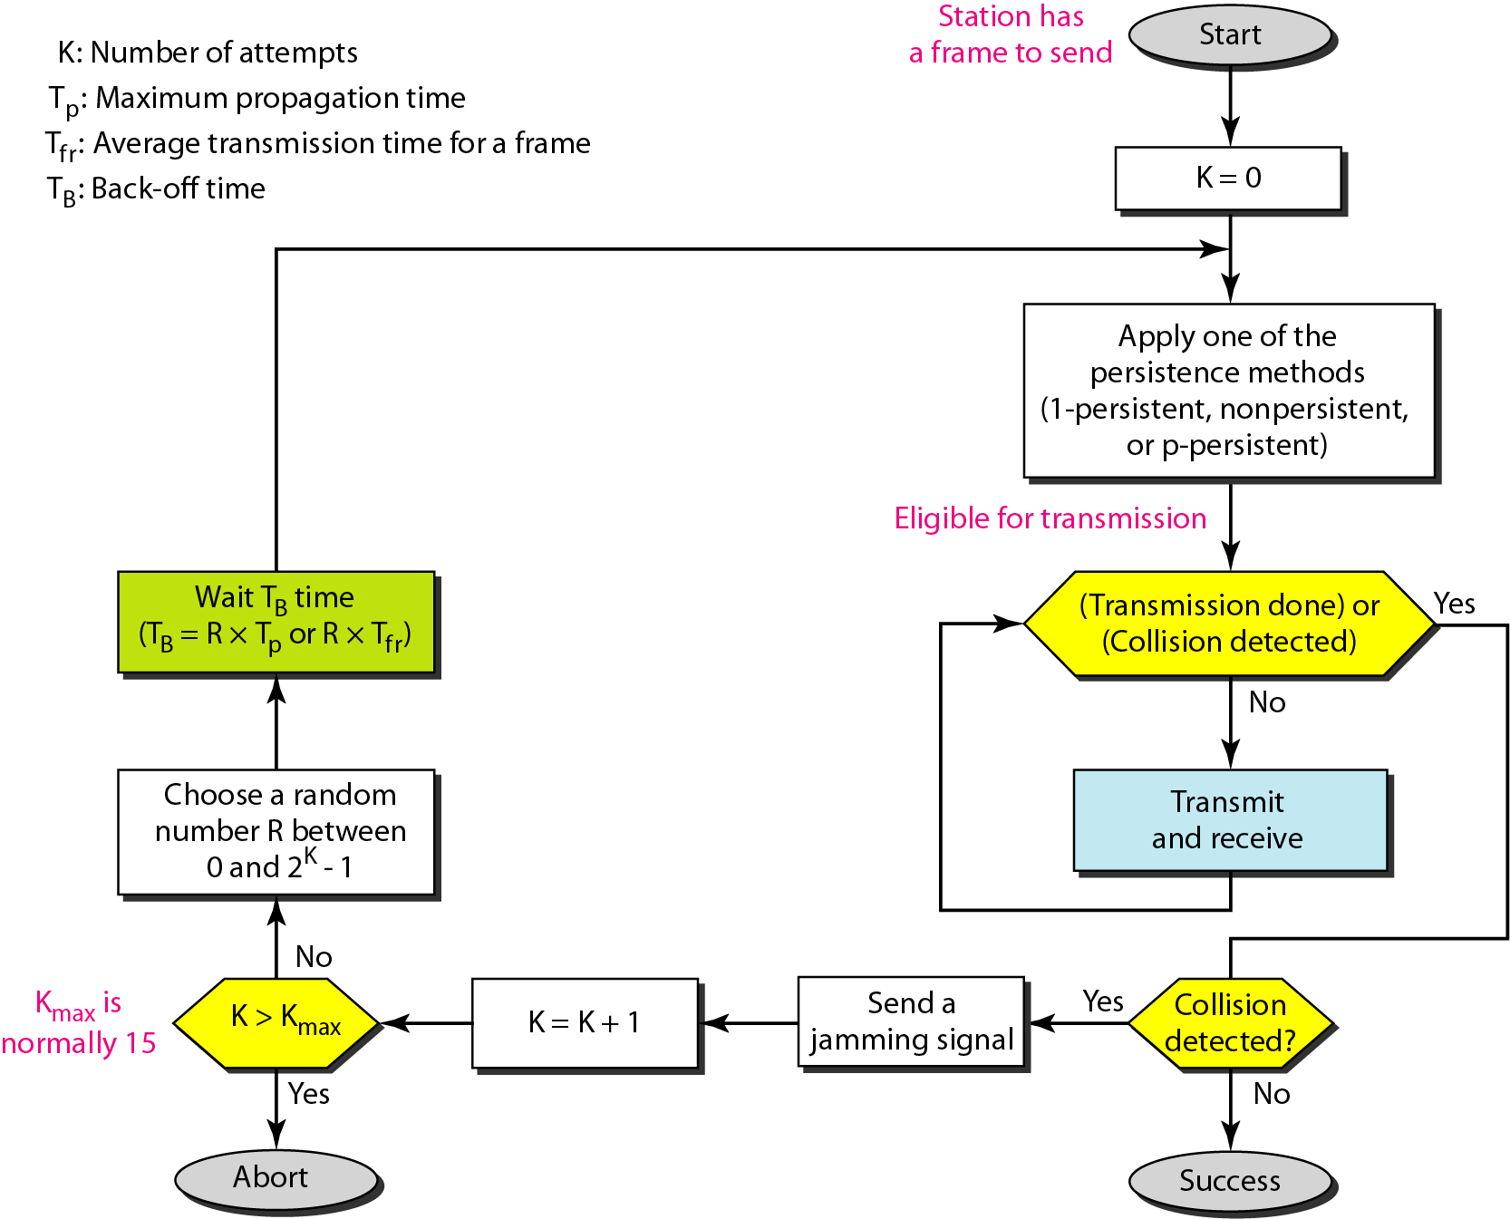
Flow Diagram: CSMA/CD
N=0
Wait R*slot time
Choose R between 0 & 2^{k} - 1
K=10
K=N
No
Yes
No
N < 10
N==16
N=N+1
Yes
Abort

Slide 61
Exponential Backoff Algorithm
Reduces the chance of two waiting stations picking the same random waiting time
When network traffic is light, it results in minimum waiting time before transmission
As congestion increases ( traffic is high), collisions increase, stations backoff by larger amounts to reduce the probability of collision.
Exponential Back off algorithm gives last-in, first-out effect
Stations with no or few collisions will have the chance to transmit before stations that have waited longer because of their previous unsuccessful transmission attempts.

Slide 62
Performance of Random Access Protocols
Simple and easy to implement
Decentralized (no central device that can fail and bring down the entire system)
In low-traffic, packet transfer has low-delay
However, limited throughput and in heavier traffic, packet delay has no limit.
In some cases, a station may never have a chance to transfer its packet. (unfair protocol)
A node that has frames to be transmitted can transmit continuously at the full rate of channel (R) if it is the only node with frames
If (M) nodes want to transmit, many collisions can occur and the rate for each node will not be on average R/M

Slide 63
DLL: So Far...
Error Control
Detection/Correction
Framing
Flow Control
Correctness (deadlock, duplication)
Efficiency (channel utilisation, sliding windows)
Medium Access
Carrier Sense/Non-Sensed
Collision Detection/Avoidance

Slide 64
How To Bootstrap an End Host?
What IP address the host should use?
What local Domain Name System server to use?
How to send packets to remote destinations?
How to ensure incoming packets arrive?
???
1.2.3.7
1.2.3.156
host
host
...
DNS
host
host
...
DNS
1.2.3.0/24
5.6.7.0/24
1.2.3.19
router
router
router

Slide 65
Avoiding Manual Configuration
Dynamic Host Configuration Protocol (DHCP)
End host learns how to send packets
Learn IP address, DNS servers, and gateway
Address Resolution Protocol (ARP)
Others learn how to send packets to the end host
Learn mapping between IP address and MAC address
???
1.2.3.7
1.2.3.156
host
host
...
DNS
host
host
...
DNS
1.2.3.0/24
5.6.7.0/24
1.2.3.19
router
router
router

Slide 66
MAC Address vs. IP Address
MAC addresses
Hard-coded in read-only memory when adaptor is built
Like a social security number
Flat name space of 48 bits (e.g., 00-0E-9B-6E-49-76)
Portable, and can stay the same as the host moves
Used to get packet between interfaces on same network
IP addresses
Configured, or learned dynamically
Like a postal mailing address
Hierarchical name space of 32 bits (e.g., 12.178.66.9)
Not portable, and depends on where the host is attached
Used to get a packet to destination IP subnet

Slide 67
MAC Addresses on a LAN
1A-2F-BB-76-09-AD
LAN
= adapter
71-65-F7-2B-08-53
58-23-D7-FA-20-B0
0C-C4-11-6F-E3-98

Slide 68
Bootstrapping Problem
Host doesn’t have an IP address yet
So, host doesn’t know what source address to use
Host doesn’t know who to ask for an IP address
So, host doesn’t know what destination address to use
Solution: shout to discover a server who can help
Broadcast a server-discovery message
Server sends a reply offering an address
host
host
...
host
DHCP server

Slide 69
Broadcasting
Broadcasting: sending to everyone
Special destination address: FF-FF-FF-FF-FF-FF
All adapters on the LAN receive the packet
Delivering a broadcast packet
Easy on a “shared media”
Like shouting in a room – everyone can hear you
E.g., Ethernet, wireless, and satellite links

Slide 70
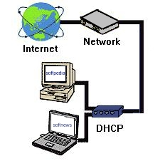
What is DHCP?
Dynamic Host Configuration Protocol
It is a method for assigning Internet Protocol (IP) addresses permanently or to individual computers in an organization’s network
DHCP lets a network administrator supervise and distribute IP addresses from a central point and automatically sends a new IP address when a computer is plugged into a different place in the network

Slide 71
Two types of IP Addresses
DHCP is used to assign IP addresses to hosts or workstations on the network
Two types of IP addresses:
Static
Is a number that is assigned to a computer by an Internet service provider (ISP) to be its permanent address on the Internet
Dynamic
The temporary IP address is called a dynamic IP address

Slide 72
Why is DHCP Important?
Important when it comes to adding a machine to a network
When computer requests an address, the administrator would have to manually configure the machine
Mistakes are easily made
Causes difficulty for both administrator as well as neighbors on the network
DHCP solves all the hassle of manually adding a machine to a network

Slide 73
How does DHCP work?
When a client needs to start up TCP/IP operations, it broadcasts a request for address information
The DHCP server will not reallocate the address during the lease period and will attempt to return the same address every time the client requests an address
The client can extend its lease or send a message to the server before the lease expires it that it no longer needs the address so it can be released and assigned to another client on the network

Slide 74
Advantages of DHCP
DHCP minimizes the administrative burden
By using DHCP there is no chance to conflict IP address
By using DHCP relay agent you provide IP address to another network

Slide 75
Disadvantages of DHCP
When DHCP server is unavailable, client is unable to access enterprises network
Your machine name does not change when you get a new IP address

Slide 76
Security problem
DHCP is an unauthenticated protocol
When connecting to a network, the user is not required to provide credentials in order to obtain a lease
Malicious users with physical access to the DHCP-enabled network can instigate a denial-of-service attack on DHCP servers by requesting many leases from the server, thereby depleting the number of leases that are available to other DHCP clients

Slide 77
Easy to set-up and administer
DHCP servers are easy to administer and can be set-up in just a few minutes
Client addresses are assigned automatically

Slide 78
Limitations
Some machines on your network need to be at fixed addresses, for example servers and routers
You need to be able to assign a machine to run the DHCP server continually as it must be available at all times when clients need IP access

Slide 79
Conclusion
Assigning client addresses automatically is by far the easiest option of the two:
Set-up automatically by DHCP server
Set-up manually
To set-up clients automatically all you need to do is set your TCP/IP control panels to receive automatically
If you intend to set up your client computers manually, make sure that the assigned IP address is in the same range of your default router address and that it is unique to your private network

Slide 80
So, Now the Host Knows Things
IP address
Mask
Gateway router
DNS server
…
And can send packets to other IP addresses
But, how to learn the MAC address of the destination?

Slide 81
So, Now the Host Knows Things
IP address
Mask
Gateway router
DNS server
…
And can send packets to other IP addresses
But, how to learn the MAC address of the destination?

Slide 82
Address Resolution
Communication On an internetwork is done by sending data at layer three using a N/W layer address.
The actual transmission of data occurs at layer two using a DLL address.
It is necessary to define some way of being able to link these two addresses.
This is done by taking a network layer address and determining what DLL address goes with it, this process is called address resolution.

Slide 83
Why Addressing Is Done At Two Different Layers?
As they are very different types of addresses those are used for diff. Purposes.
Layer two addresses(IEEE 802 MAC addresses)are used for local transmission b/w h/w devices that can communicate directly.
In contrast layer three addresses(IP addresses) are used in internetworking.

Slide 84
Why AR Is Necessary?
If a client on the local n/w is accessing a server somewhere on the internet.
Logically this connection can be made directly b/w the client and server.
But in reality is a sequence of physical links at layer two.

Slide 85
Why AR is necessary?(Contd.)
At each step the decision of where to send the data is made based on a layer three address.
But the actual transmission must be performed using layer two address.

Slide 86
Sending Packets Over a Link
1.2.3.53
1.2.3.156
host
host
...
Web
IP packet
1.2.3.53
1.2.3.156
router
Adaptors only understand MAC addresses
Translate the destination IP address to MAC address
Encapsulate the IP packet inside a link-level frame

Slide 87
ARP: Address Resolution Protocol
ARP is a relatively simple request/reply protocol.
The source device broadcasts an ARP request looking for a particular device based on it IP address.
The device responds with its h/w address in an ARP reply message.

Slide 88
ARP: Address Resolution Protocol
Note:
The Internet is based on IP addresses
Data link protocols (Ethernet, FDDI, ATM) may have different (MAC) addresses
The ARP and RARP protocols perform the translation between IP addresses and MAC layer addresses

Slide 89
Address Resolution Protocol
Every node maintains an ARP table
(IP address, MAC address) pair
Consult the table when sending a packet
Map destination IP address to destination MAC address
Encapsulate and transmit the data packet
But, what if the IP address is not in the table?
Sender broadcasts: “Who has IP address 1.2.3.156?”
Receiver responds: “MAC address 58-23-D7-FA-20-B0”
Sender caches the result in its ARP table
No need for network administrator to get involved

Slide 90
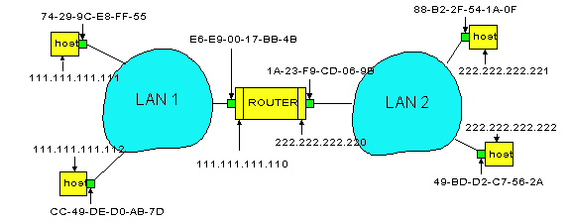
Example: A Sending a Packet to B
How does host A send an IP packet to host B?
A
R
B
A sends packet to R, and R sends packet to B.

Slide 91
Host A Sends Packet Through R
Host A learns the MAC address of R’s interface
ARP request: broadcast request for 111.111.111.110
ARP response: R responds with E6-E9-00-17-BB-4B
Host A encapsulates the packet and sends to R
A
R
B

Slide 92
R Sends Packet to B
Router R’s learns the MAC address of host B
ARP request: broadcast request for 222.222.222.222
ARP response: B responds with 49-BD-D2-C7-56-2A
Router R encapsulates the packet and sends to B
A
R
B

Slide 93
Conclusion
Important control functions
Bootstrapping
Error reporting and monitoring
Internet control protocols
Dynamic Host Configuration Protocol (DHCP)
Address Resolution Protocol (ARP)
Internet Control Message Protocol (ICMP)

